Slide 1
Python overview

Slide 2
Intro
Python is a high-level, interpreted, interactive and object-oriented scripting language.
Python is designed to be highly readable.
It uses English keywords frequently where as other languages use punctuation, and it has fewer syntactical constructions than other languages.

Slide 3
Intro 2
Python is Interpreted: Python is processed at runtime by the interpreter. You do not need to compile your program before executing it. This is similar to PERL and PHP.
Python is Interactive: You can actually sit at a Python prompt and interact with the interpreter directly to write your programs.
Python is Object-Oriented: Python supports Object-Oriented style or technique of programming that encapsulates code within objects.
Python is a Beginner's Language: Python is a great language for the beginner-level programmers and supports the development of a wide range of applications from simple text processing to WWW browsers to games.

Slide 4
History of python
Python was developed by Guido van Rossum in the late eighties and early nineties at the National Research Institute for Mathematics and Computer Science in the Netherlands.
Python is derived from many other languages, including ABC, Modula-3, C, C++, Algol-68, SmallTalk, and Unix shell and other scripting languages.
Python is copyrighted. Like Perl, Python source code is now available under the GNU General Public License (GPL).

Slide 5
Python features
Easy-to-learn
Easy-to-read
Easy-to-maintain
A broad standard library
Interactive Mode
Portable
Extendable
Databases
GUI Programming
Scalable

Slide 6
How python works
How your python code gets executed?
The python code you write is compiled into python bytecode, which creates file with extension .pyc.
Compiled in to intermediate code not into machine code

Slide 7
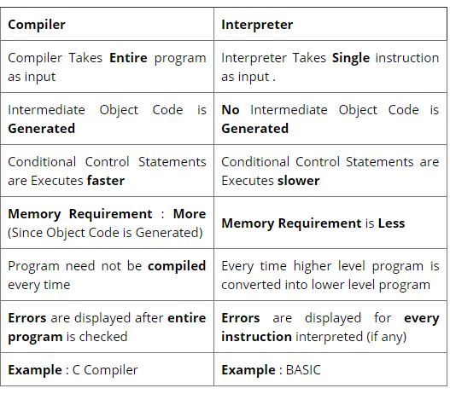
How python works cont.
Compiler - generates fast machine code
Interpreter - generates bytecode

Slide 8
Python first program
Open cmd and type `python`
$ python Python 2.4.3 (#1, Nov 11 2010, 13:34:43) [GCC 4.1.2 20080704 (Red Hat 4.1.2-48)] on linux2 Type "help", "copyright", "credits" or "license" for more information. >>>
>>> print "Hello, Python!"
Hello, Python!

Slide 9
Python pass arguments
$ python test.py arg1 arg2 arg3
#!/usr/bin/python import sys print 'Number of arguments:', len(sys.argv), 'arguments.' print 'Argument List:', str(sys.argv)
Number of arguments: 4 arguments. Argument List: ['test.py', 'arg1', 'arg2', 'arg3']

Slide 10
Python identifiers
A Python identifier is a name used to identify a variable, function, class, module or other object. An identifier starts with a letter A to Z or a to z or an underscore (_) followed by zero or more letters, underscores and digits (0 to 9).
Python does not allow punctuation characters such as @, $, and % within identifiers. Python is a case sensitive programming language. Thus, Manpower and manpower are two different identifiers in Python.
Here are naming conventions for Python identifiers −
Class names start with an uppercase letter. All other identifiers start with a lowercase letter.
Starting an identifier with a single leading underscore indicates that the identifier is private.
Starting an identifier with two leading underscores indicates a strongly private identifier.
If the identifier also ends with two trailing underscores, the identifier is a language-defined special name.

Slide 11
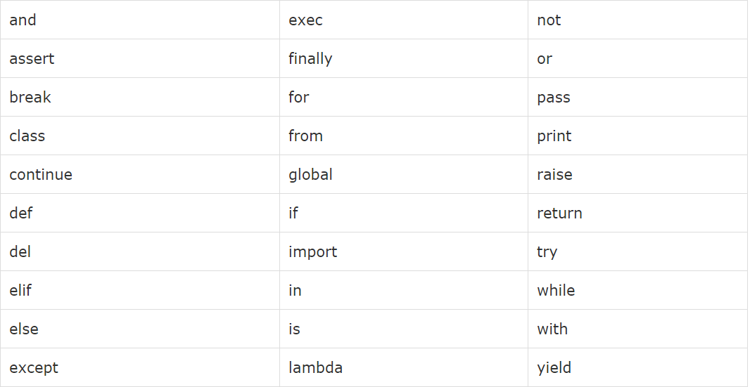
Reserved words

Slide 12
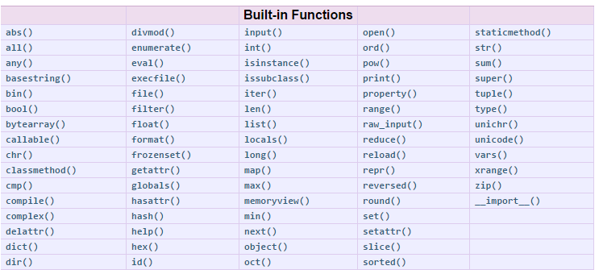
Build-in functions

Slide 13
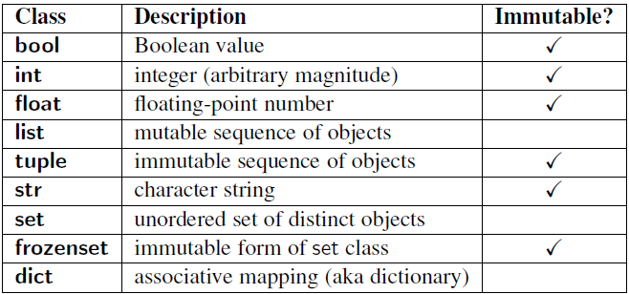
Data structures

Slide 14
Everything in python is an Object
Everything in Python is an object, and almost everything has attributes and methods even None.

Slide 15
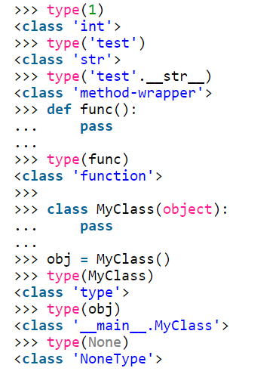
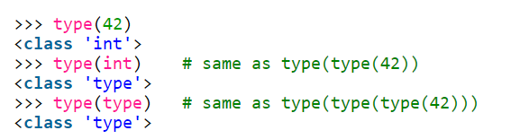
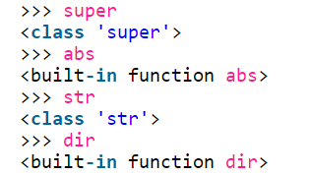

Slide 16
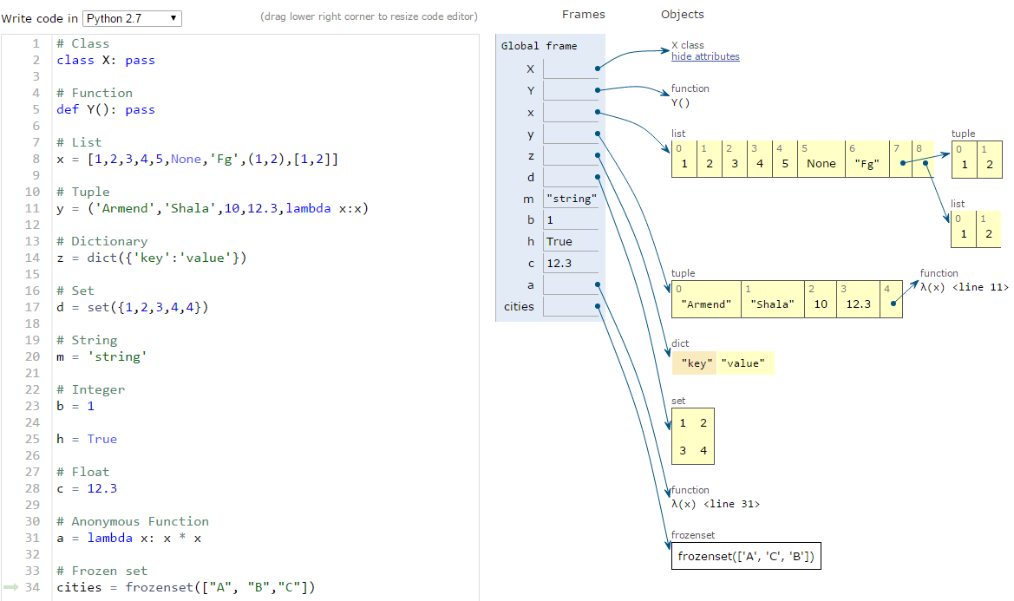
Example

Slide 17
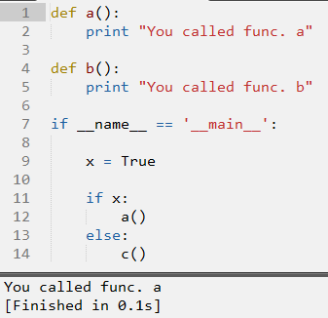
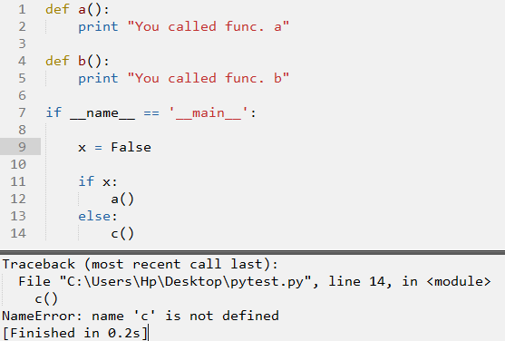
Workflow
Python is an interpreted language (runtime).

Slide 18
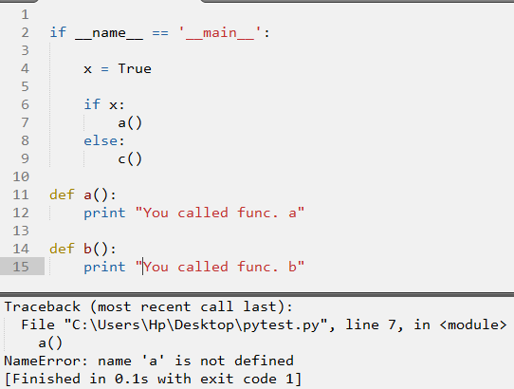
Workflow cont.
Python runs the program from top-down

Slide 19
Questions ?

